Slide 1
Music Analytics with Spotify – Data Storage
Intermediate Graph Database Programming for Business Analytics 2021

Slide 2

Storing Data in Graph DBMS (Neo4j)
Part B: Data Storage

Slide 3
Common SQL (Cypher) Commands
CREATE CONSTRAINTS: https://neo4j.com/docs/cypher-manual/current/administration/constraints/
CALL stored procedures to efficiently load and insert data – APOC (Awesome Procedures on Cypher – named after The Matrix)
Some 450 ready made procedures: https://neo4j.com/developer/neo4j-apoc/
CALL apoc.periodic.iterate
CALL apoc.load.csv
apoc.convert.fromJsonList(row.genres)
YIELD – to get the output from a procedure CALL
WITH variable
AS – an alias
MERGE entities (CREATE & MATCH)
CREATE relationships
SET properties e.g., musical characteristics

Slide 4
Database Constraints & Indexes
Constraints – a mandatory requirement that:
Spotify Song ID is UNIQUE
Artists names is UNIQUE
Indexes – a gateway leading to many paths of entities & relationships (if exist)
The thread between the different data files, or the primary linkages between data entities i.e., the links in each row of data in each file – there are columns in each that to establish links or relationships
Entryway into pattern matching

Slide 5
The STEPS to LOAD data & CREATE relationships
STEP 1:
LOAD the main CSV data, file named: ‘data.csv’
SQL command file: data_insert.cql
Notes: musical characteristics are for songs
STEP 2:
LOAD the data contained in the CSV file named: data_w_genres.csv
SQL command file: artists_genre_insert.cql
Notes: musical characteristics are for artists
Notes: since the musical characteristics in this file is for artists, there is duplicate information in the CSV file ‘data_by_artists.csv’
STEP 3:
LOAD data contained in the file named: data_by_genres.csv
SQL command file: data_by_genres_insert.cql
Notes: musical characteristics are for genres
STEP 4:
LOAD data contained in the file named: data_by_year.csv
SQL command file: data_by_year.cql

Slide 6
STEP 1: LOAD Songs Data
File: data.csv
The Commands: data_insert.cql
Contains musical characteristics for songs (tracks)
Contains: 170,653 songs spanning 100 years
Can be one or more artists
Use “APOC” batch processing to quickly load CSV data
Upon load, create the entities or nodes:
(:Songs)
(:ArtistsTmp) – A temporary placeholder
(:Years)
Create relationships between songs, artists and years
CREATE CONSTRAINTS
CALL stored procedures to efficiently load and insert data
WITH variable
MERGE entities
CREATE relationships
SET properties e.g., musical characteristics
YIELD map

Slide 7
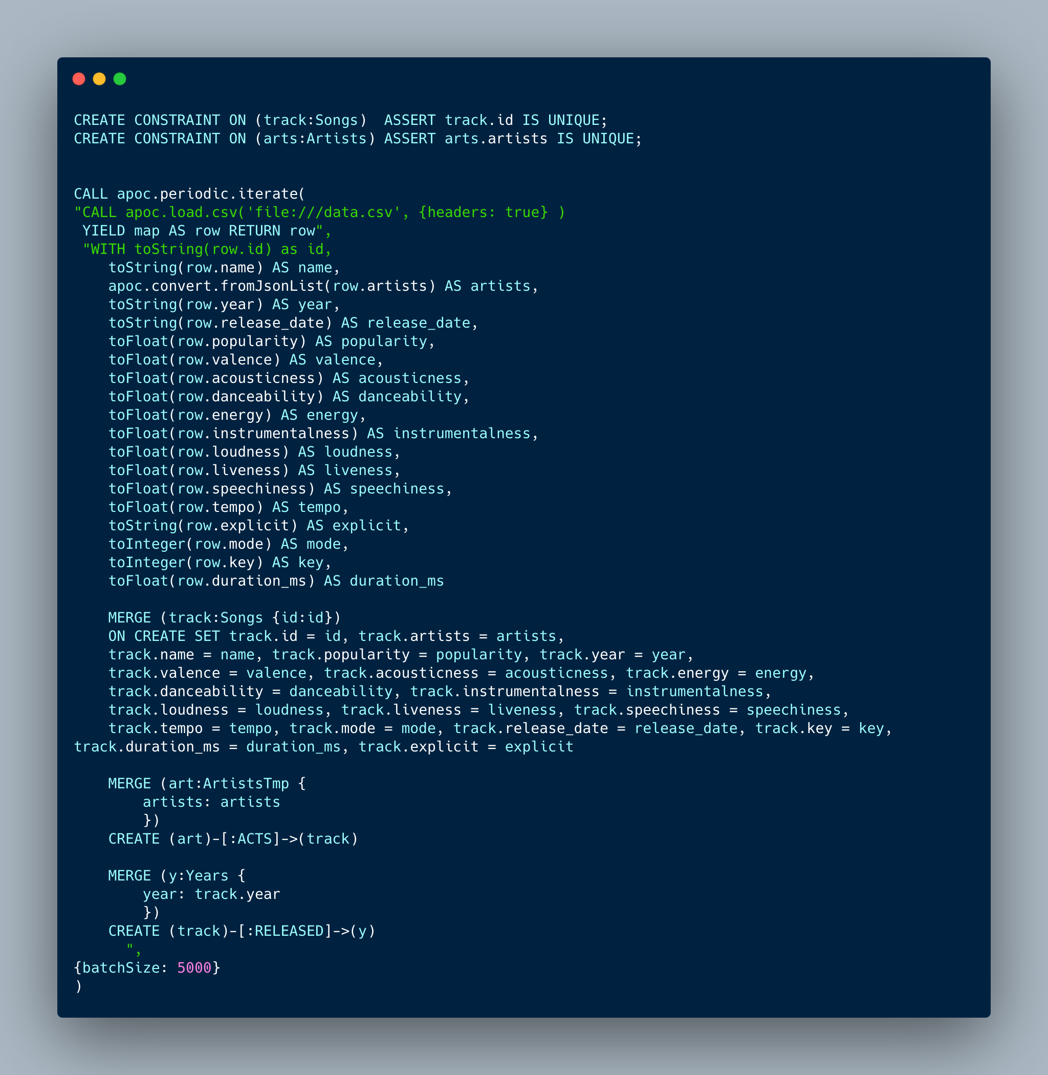
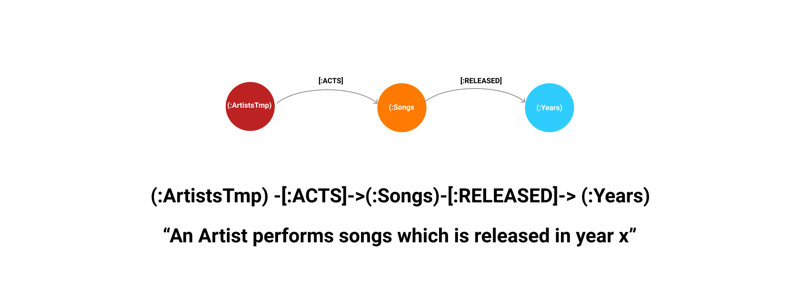
Songs Database Commands
Command file: data_insert.cql
LOADS csv data
Reads data one row at a time AND across columns
Converts data to correct formats and alias using the AS keyword
Apply MERGE command to CREATE entities (if they do no exist)
CREATE relationships once the entities have been created

Slide 8
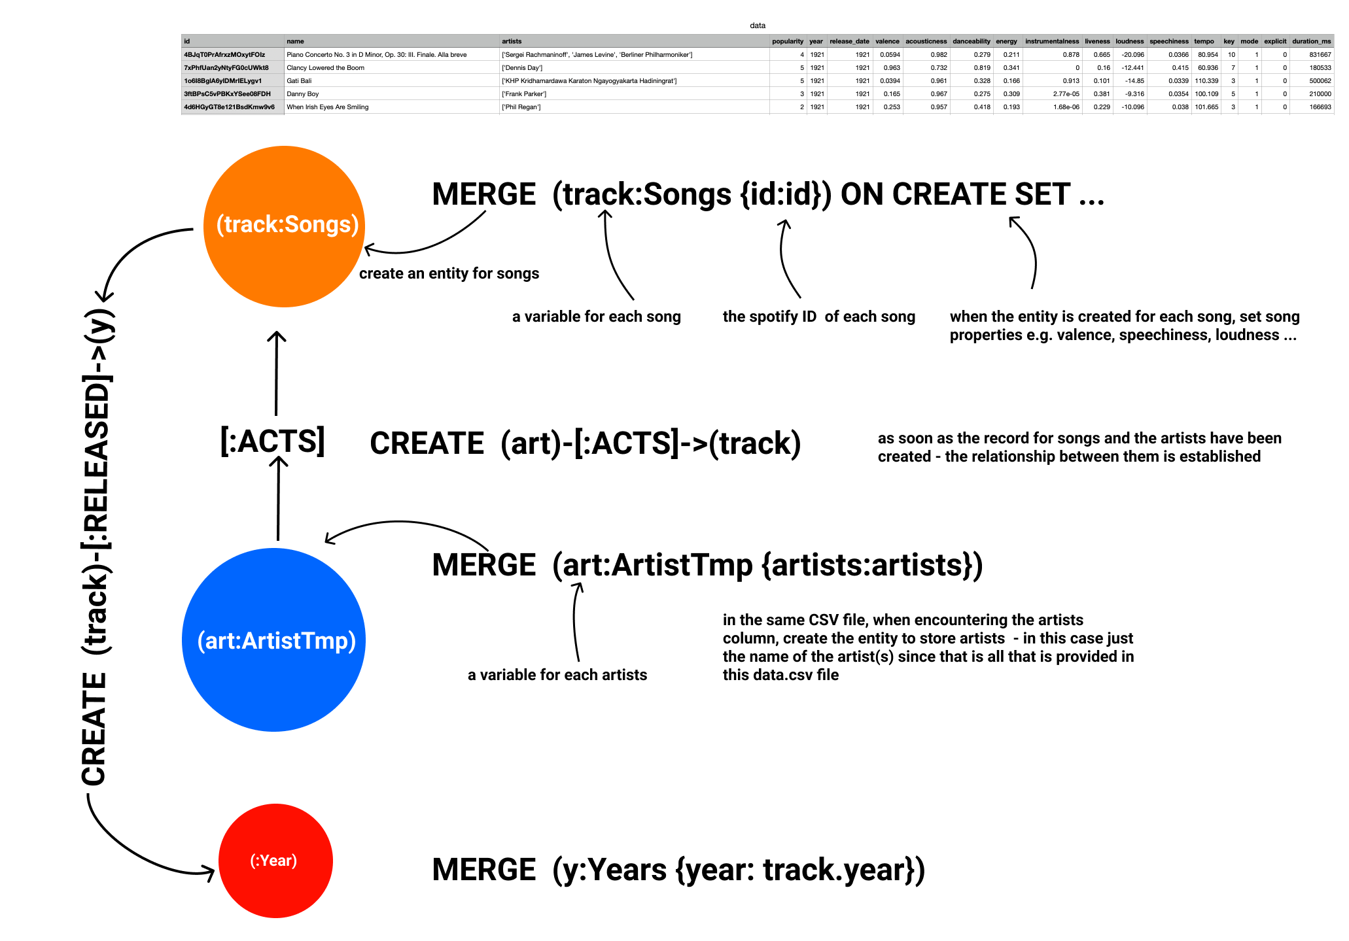

Slide 9

Further Explanations
Why create temporary records for Artists?
Because the musical characteristics are for the songs (not the artists) and the only information about the artist are their name(s)
Also because we can immediately create relationships between the songs and the artists, as well as the year that the song(s) was released i.e. we take advantage of the fact that a relationship between the artists, songs and year exists in the same CSV file
The data is the CSV file, ‘data_w_genres’, contains information on the musical characteristics for the artists, which will give us the opportunity to create and set data records for (:Artists)

Slide 10
STEP 2: LOAD Artists Data
“data_w_genres.csv”
The Commands
Contains musical characteristics for artists (not genres)
Contains: 28,680 individual artists spanning 100 years
Use “APOC” batch processing to quickly load CSV data
Upon load, create the entities or nodes:
(:Arts) – a temporary placeholder
(:Genres)
Create relationships between artists (:Arts) and (:Genres)
CREATE CONSTRAINTS
CALL stored procedures to efficiently load and insert data
WITH variable
MERGE entities
CREATE relationships
SET properties i.e., musical characteristics

Slide 11
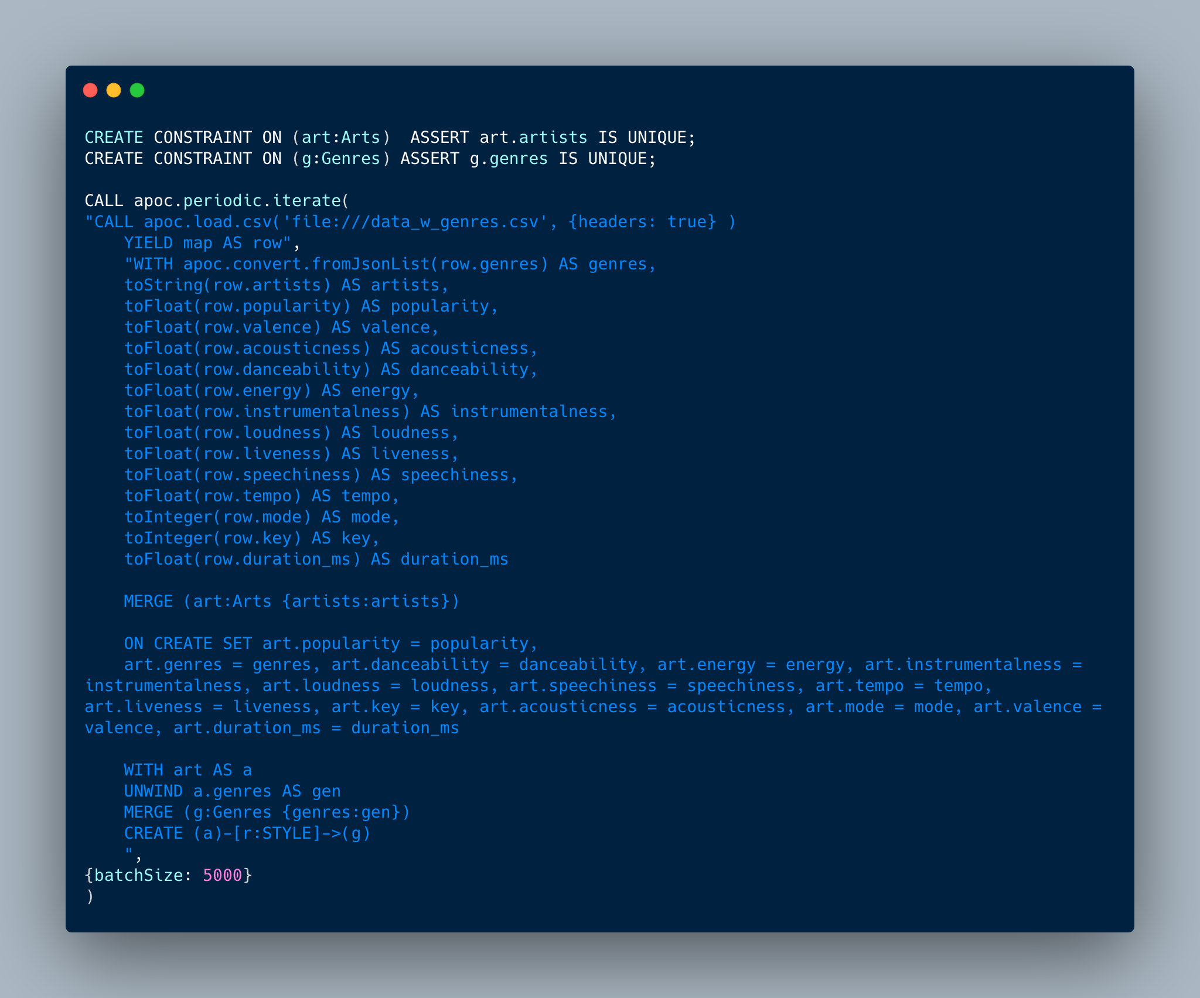
STEP 2: Artists Data (Continued…)
Notes:
Since this CSV contains information on the type(s) of genres that the artist(s) performs, this gives us the opportunity to create relationships between the artists and the genres
However, remember that STEP 1 already created (:ArtistsTmp), which is a temporary placeholder as it only stores the artist’s name(s) BUT, importantly, it was used to create relationships between the song(s), artist(s), and year of release of the song(s)

Slide 12
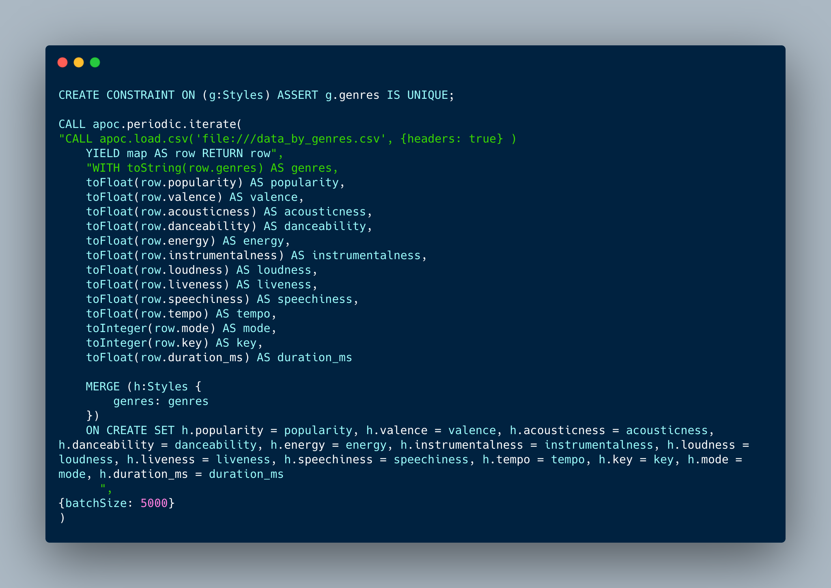
STEP 3: LOAD Genres Data
Genres will be temporarily called the (:Styles) entity (or data records)
Remember that when loading the artist(s) data, there was a column that identified what genre(s) the artist(s) performed in – but that data did not contain the actual musical characteristics for each genre
Later, (:Styles) and (:Genres) data records will be consolidated

Slide 13
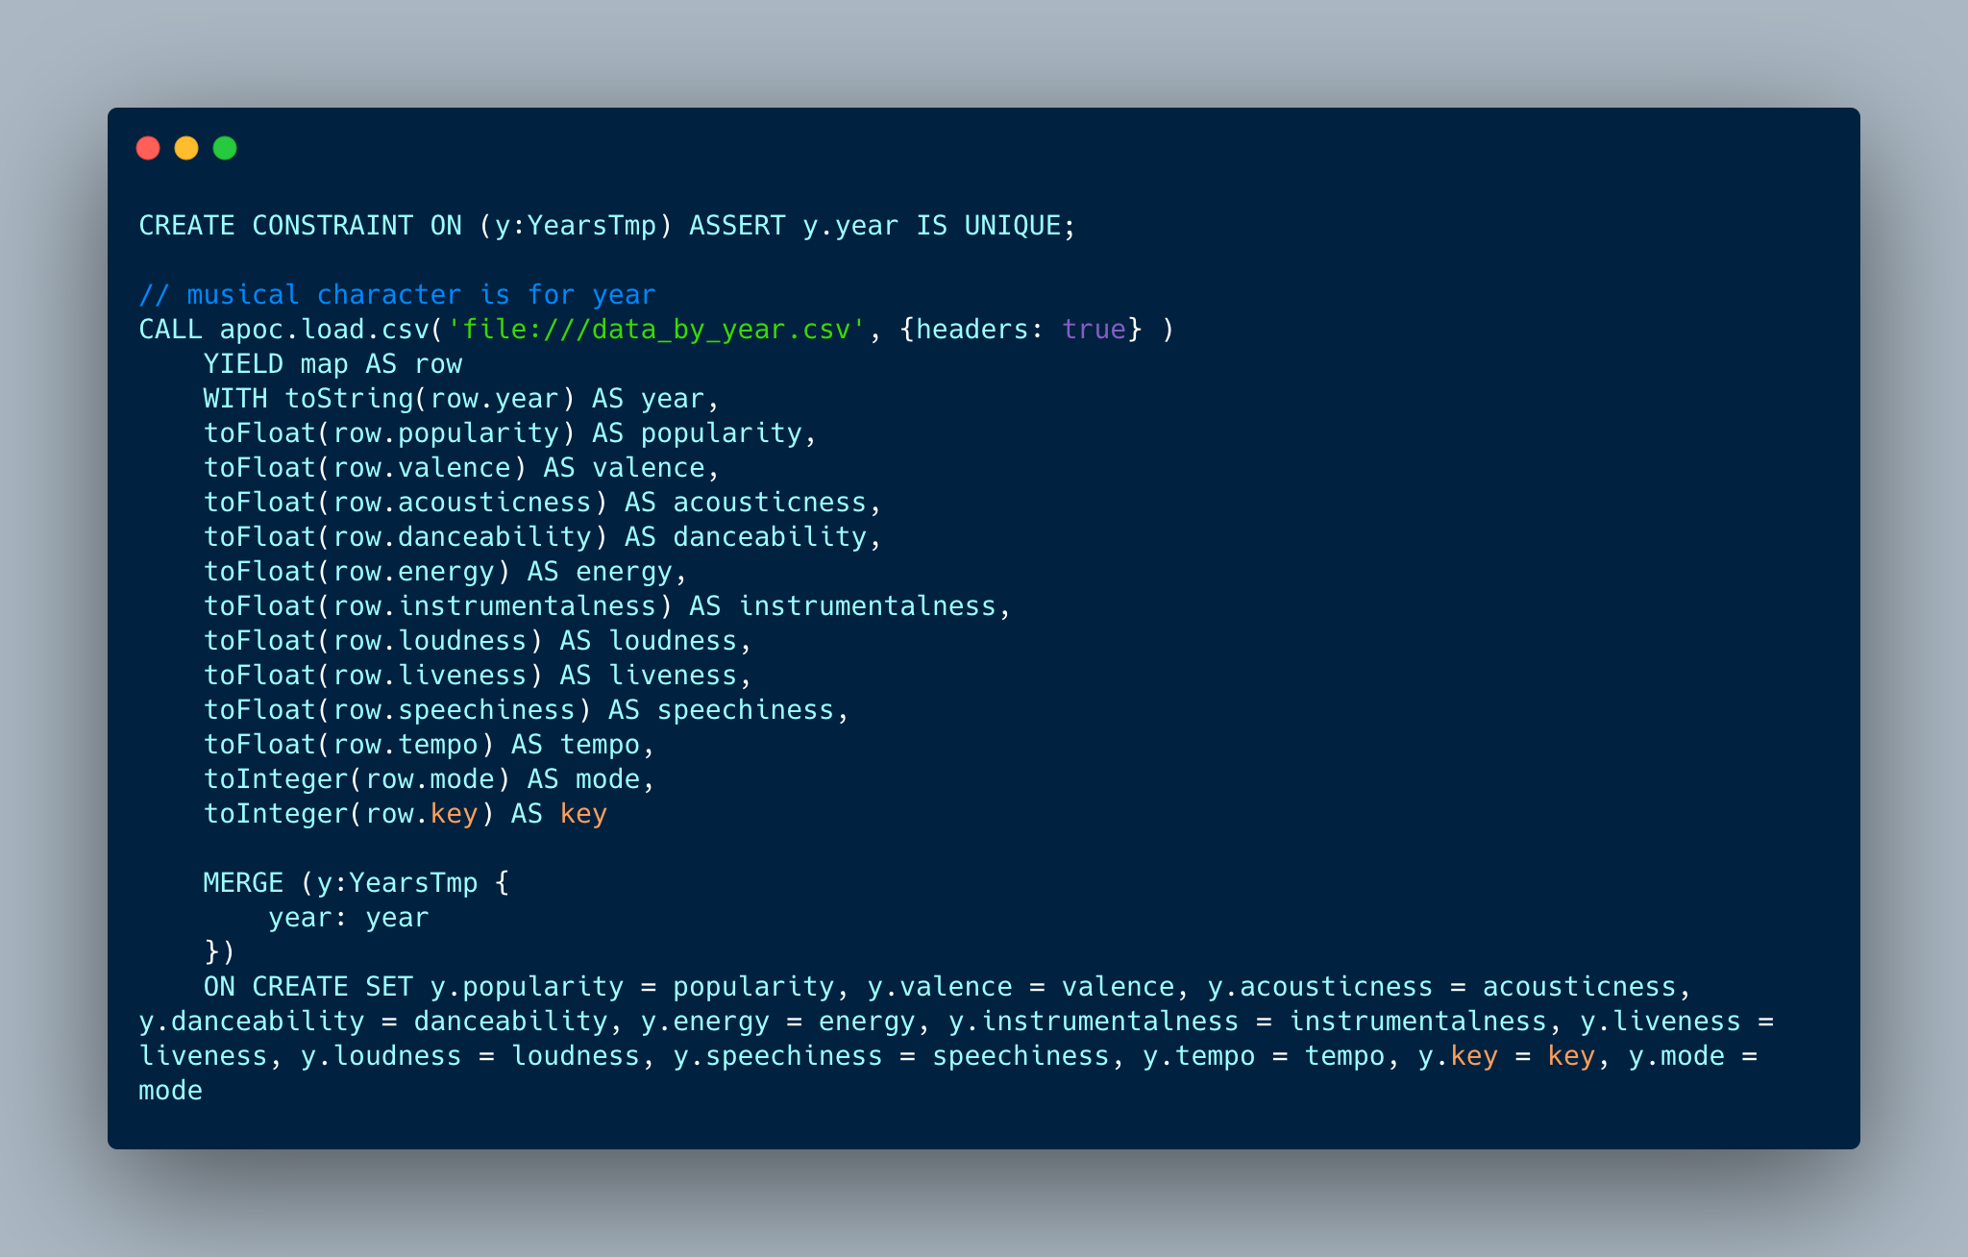
STEP 4: LOAD Years Data
Years data contains the musical characteristics for the Year, in this case the label for this data record is (:YearsTmp) because, when loading the data for the songs, a (:Years) entity was already created
Where (:Years) was created because a relationship between the songs and artists was made, it only contained the year of release information – not the musical characteristics for the year
Later, (:YearsTmp) and (:Years) must be consolidated since (:YearsTmp) has all the musical characteristics information

Slide 14
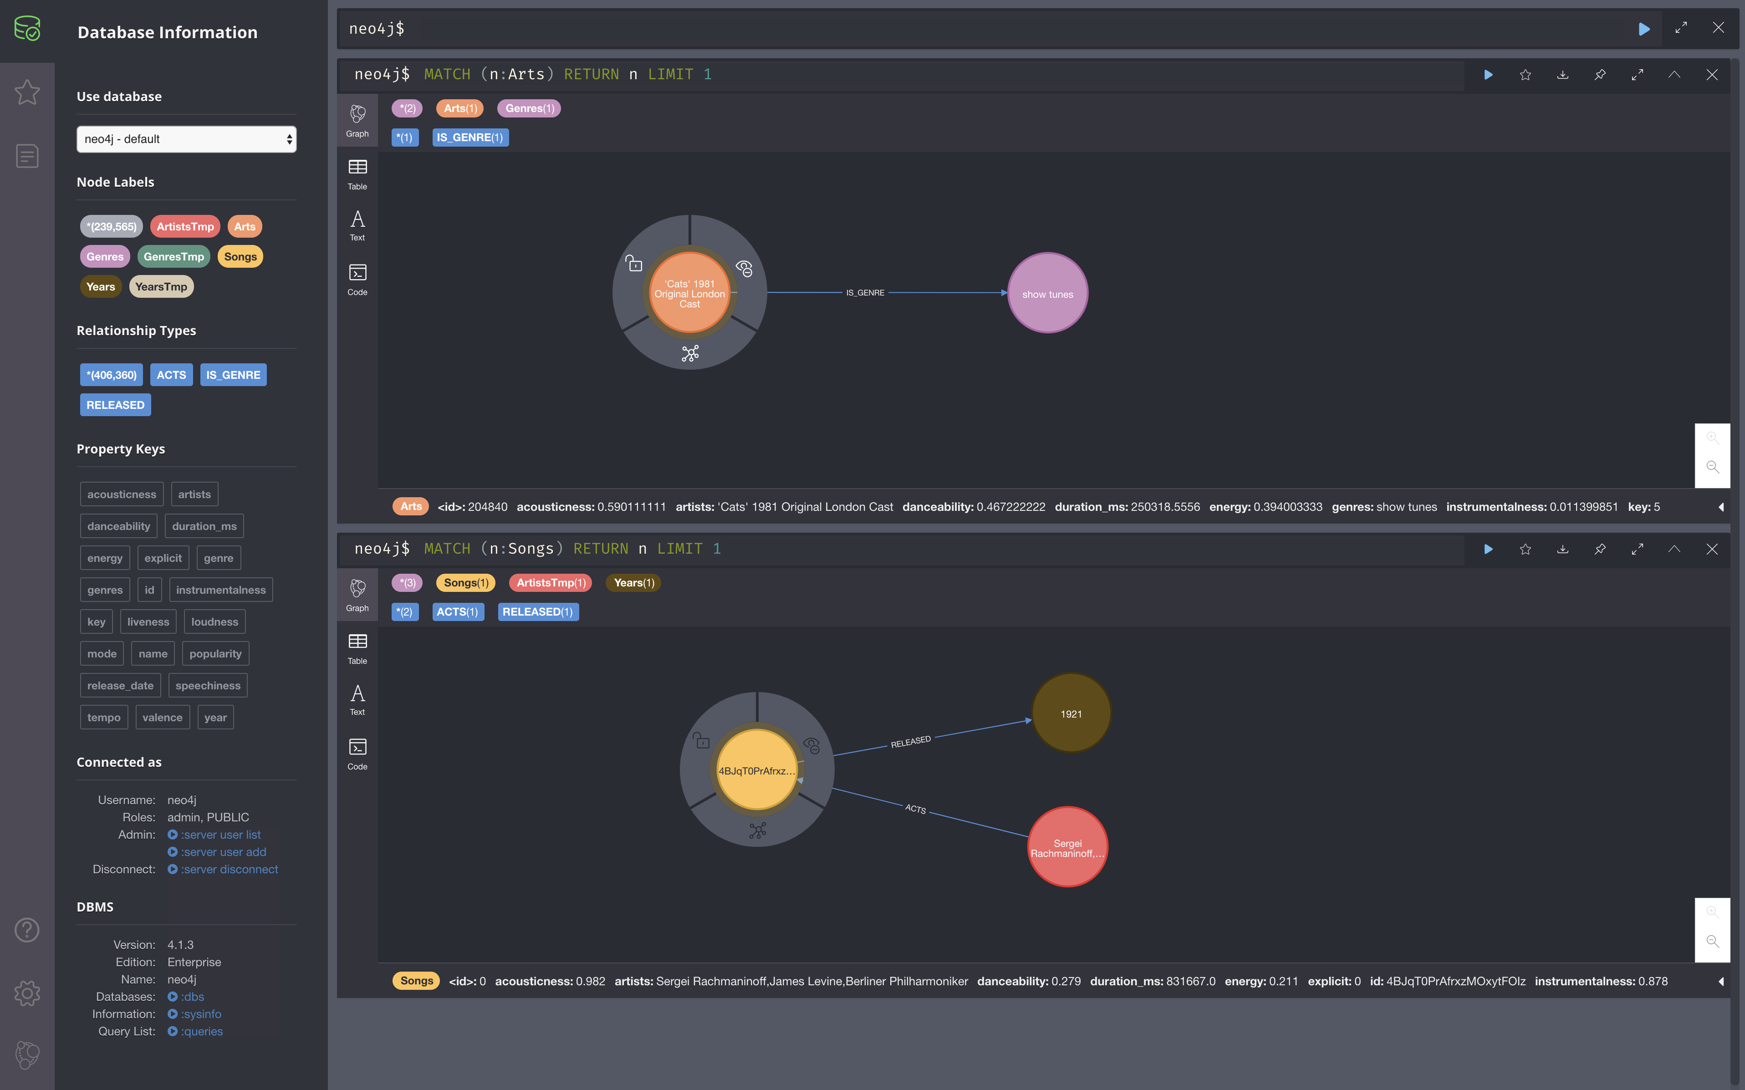
Loading Data Results
Once all the CSV data has been loaded and records created in the database, the Node Labels (entities), Relationship Types, and Property Keys, can be seen on the left-hand navigation panel

Slide 15
DBMS Summary
There are 7 types of nodes or entities:
(:ArtistsTmp) - for the name of the artists related to the (:Songs) and (:Years)
(:Arts) – for the artists & musical characteristics
(:Years) – contains the year & has relationship with (:Songs) and (:ArtistsTmp)
(:YearsTmp) – contains the year and its musical characteristics
(:Genres) – containing the name of the genres
(:Styles) – contains the name and musical characteristic for the genres concerned
(:Songs) – contains the track ID (song) and its musical characteristics
239,565 entities in total
3 types of relationships:
[:ACTS], [:IS_GENRE], [:RELEASED]
406,360 relationships
Properties: the musical characteristics
Next steps:
MERGE nodes together
(:ArtistsTmp) and (:Arts) to finally CREATE (:Artists) and (:Musicians) entities
(:Years) and (:YearsTmp) – copy data from (:YearsTmp) to (:Years)
(:Genres) and (:Styles) – copy data from (:GenresTmp) to (:Genres)
Once nodes have been merged, remove unnecessary entities placeholders
Then, perform analysis to address business questions

Slide 16
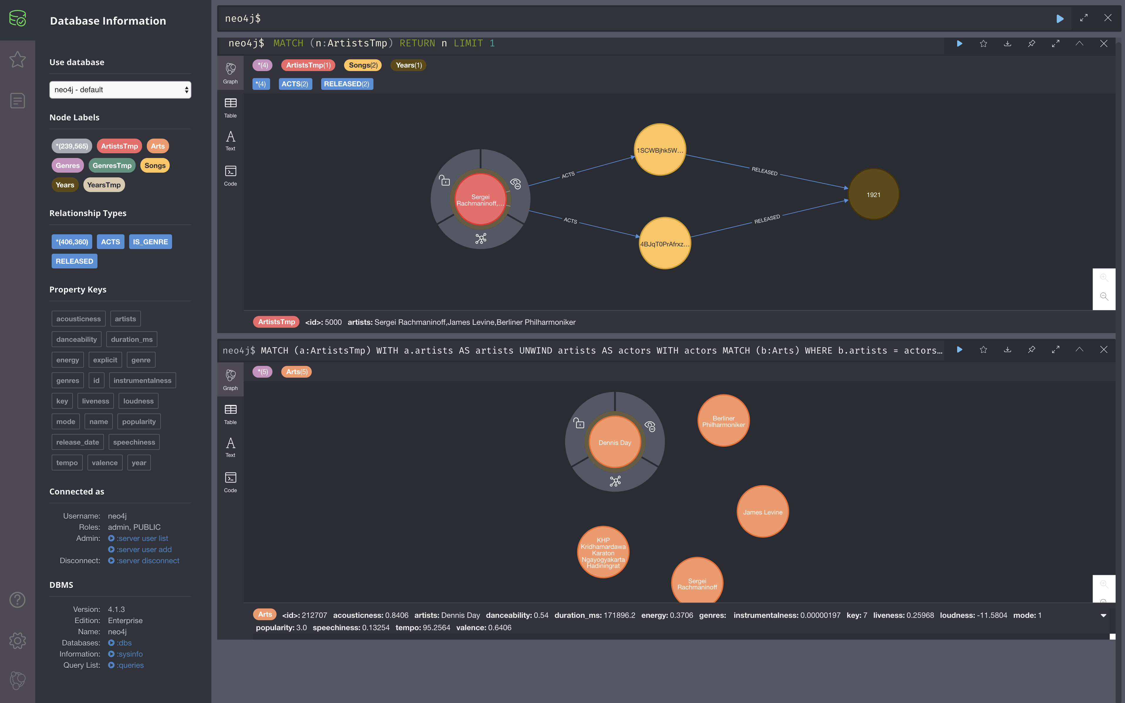
(:ArtistsTmp), (:Arts)

Slide 17
(:ArtistsTmp), (:Arts)
Per (:Song), (:ArtistsTmp) can be
performed by a group of artists
performed by a single artist
(:Arts) is per artist (not a group of artists)
It is possible that the artist has not been classified into some genre
Since a song can have many performers a merging of the two nodes (:ArtistsTmp) and (:Arts) would not be correct
The correct way is to:
Re-label (:ArtistsTmp) to (:Musicians) – since the record may contain many artists
Re-label (:Arts) to (:Artists)
Then, link (:Muscians)-[:HAS_ARTISTS]->(:Artists)
Preserving both of their existing relationships to other entities

Slide 18
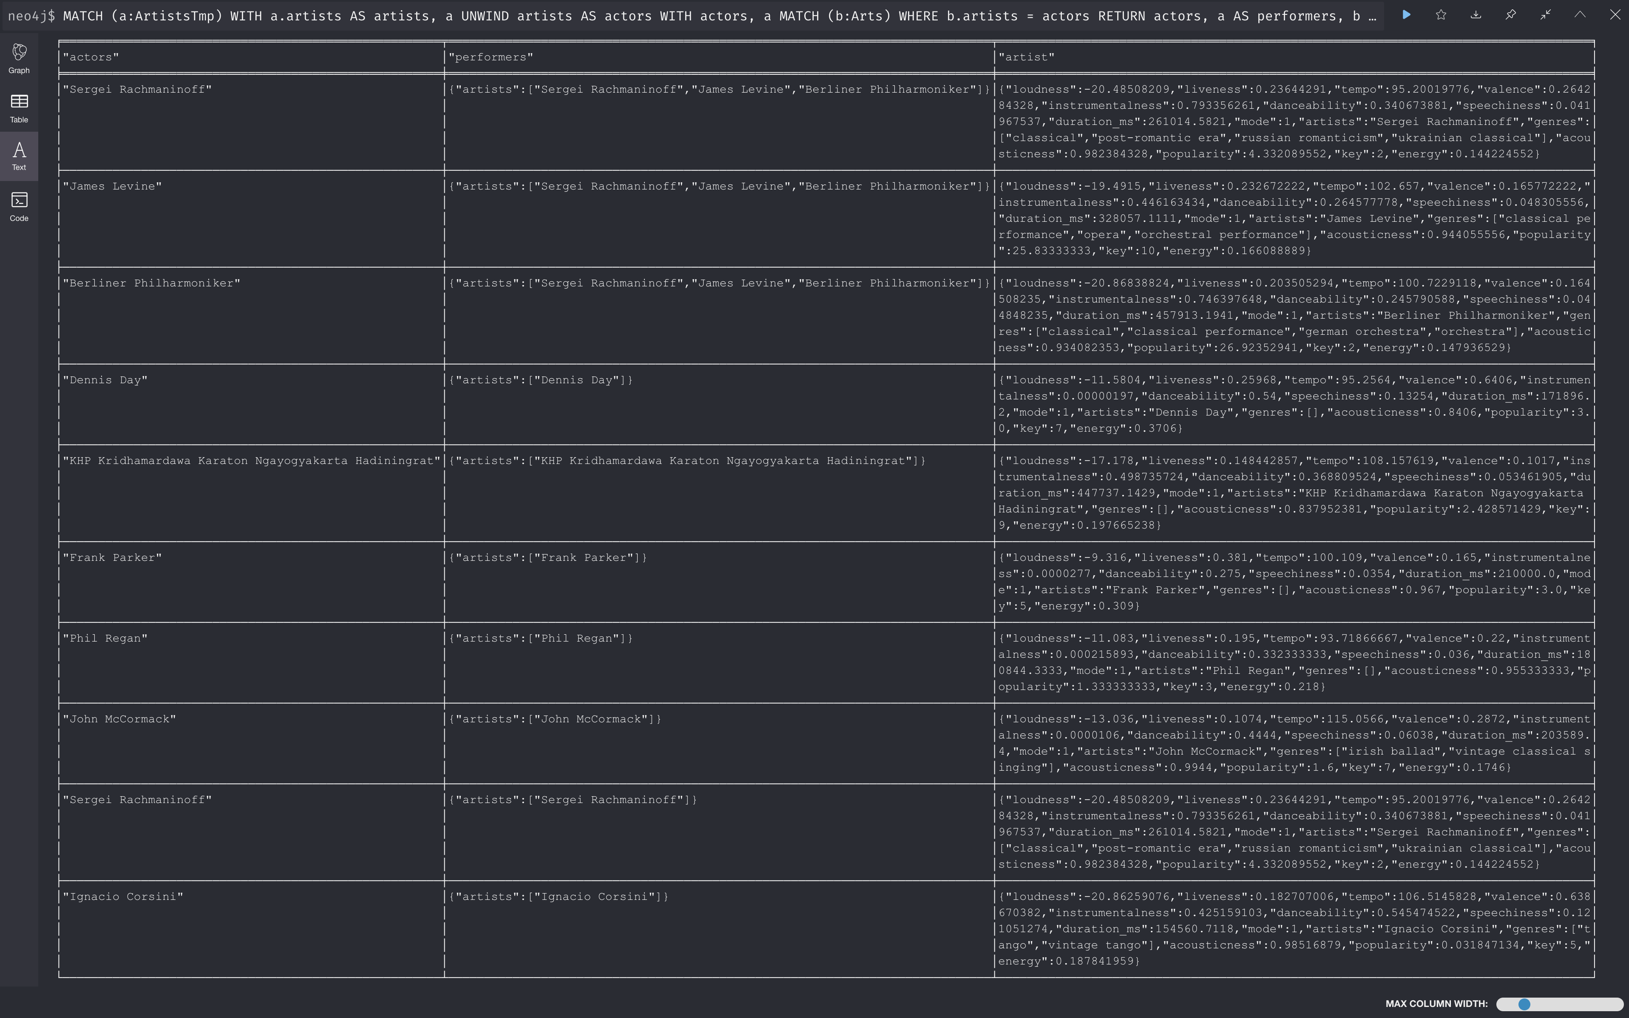
(:ArtistsTmp), (:Arts)

Slide 19
Storing Data in Graph DBMS (Neo4j)
Next: Part C – Business Analytics

